Slide 1

Project Viva Presentation
on
Medicinal Plant Identification
by Preshit Sharma(RA1711004010381)
Rashika Sharma(RA1711004010433)
Nitika Bagga(RA1711004010549)
Under the guidance of
Mr.R.Prithviraj
Assistant Professor, Department of ECE

Slide 2
INDEX
CONTENTS | PAGE NO
ABSTRACT | 1
LITERARTURE SURVEY | 2-3
PROBLEM STATEMENT | 5
OBJECTIVE | 6
NOVELTY | 7
PROPOSED STUCTURE | 8-9
METHODOLOGY | 10-12
HARWARE/SOFTWARE REQUIREMENTS | 13
USER INTERFACE | 14
RESULTS | 15
GUI LAYOUT AND UTILITIES | 16
CONCLUSION | 17
APPLICATIONS | 18
REFERENCES | 19

Slide 3
ABSTRACT
Ayurveda is an ancient medicine practice which is mostly based on plants.
These treatments are implemented using leaves, roots, fruits, seeds and bark of the plant.
So in this project different ways are suggested for identification of these plants using image processing of leaf image, extracting features like leaf shape/contour, leaf texture, leaf color and then comparing these features with the leaf data in database, finally displaying leaf name and properties based upon the match.
1.

Slide 4
Literature Survey
S.No | Author | Paper Title | Journal Details | Inference
1. | Nursuriati Jamil, Nuril Aslina Che Hussin, Sharifalillah Nordin, Khalil Awang | Automatic Plant Identification: Is Shape the Key Feature | Automatic Plant Identification: Is Shape the Key Feature?, Procedia Computer Science, Volume 76, 2015, Pages 436-442, ISSN 1877-0509, | This preliminary study revealed that texture is the feature that highly influenced the identification rate.
2. | Rahul Yadav, Upasana Dugal | A SurveyonLeaf Identification throughLeaf FeaturesUsing Image Processing | A Survey on Leaf Identification through Leaf Features Using Image Processing. Vol. 7, Issue 5, May 2018 ISSN(Online): 2319-8753 | It makes a difference to the leaves by its margin better than its shape or texture. The more we combine features of the leaves the more optimized difference will be obtained between the sample of leaves.
2.

Slide 5
3. | Identification of Ayurvedic Medicinal Plants by Image Processing of leaf samples | TejasD.Dahigaonkar, Rasika T. Kalyane | Identification of Ayurvedic Medicinal Plants by Image Processing of leaf samples Volume: 05 Issue: 05 | May-2018 ISSN: 2395-0056 | Thus, a unique methodology for identification of Ayurvedic medicinal plants from images has been proposed. A unique combination of geometric, color and texture feature have been identified to maximizes the accuracy of identification.
4. | Automated plant species identification—Trends and future directions | Jana Wäldchen , Michael Rzanny, Marco Seeland, Patrick Mäder | Wäldchen J, Rzanny M, Seeland M, Mäder P (2018) Automated plant species identification—Trends and future directions. PLoS Comput Biol 14(4): e1005993. | A structured observation approach with well defined image conditions (e.g., Flora Capture) is beneficial for finding a balance between a tedious observation process acquiring every possible scenario and a superficial acquisition that misses the characteristic images required for training.
5. | Ayurvedic Herb Detection using Image Processing | Dinesh Shitole, Faisal Tamboli, Krishna Motghare, Raj Kumar Raj | "Ayurvedic Herb Detection using Image Processing" Published in International Journal of Trend in Scientific Research and Development (ijtsrd), ISSN: 2456- 6470, Volume-3 | Issue-4, June 2019, pp.491-494, URL: https://www.ijtsrd. com/papers/ijtsrd2 3605.pdf | This system introduces a statistical method for plant leaf identification. Proposed method is verified for a database of 4 plants. This system proposes identification of selected medicinal plant leaves from a stored data base of the leaves by processing an image of their leaves. Such automated classification mechanisms can be useful for efficient classification of plant leaf species.
3.

Slide 6
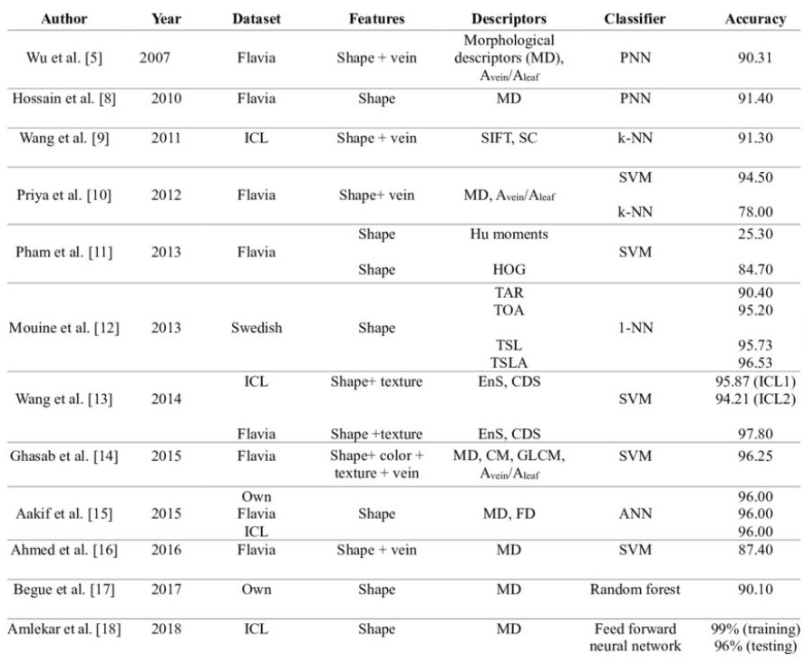
Data from previous studies
4.

Slide 7
PROBLEM STATEMENT
Due to the lack of awareness about commonly found medicinal plants it is difficult for a layman to identify the species of the plant.
Computer vision models distinguishes plants on the basis of one of the features of leaf i.e. shape, texture, colour and veins.
Previous models required huge datasets of stored information regarding uses and properties of plants with leaf images.
Hence the project requires alternative methods to reduce memory requirement and improve accuracy.
5.

Slide 8
OBJECTIVE
To recognize leaf using contour based edge detection.
To extract texture and color based features.
To study features using classifier i.e. SVM( Support Vector Machine).
To determine performance of the model.
To output botanical name of the leaf.
To display uses and properties of the test leaf.
6.

Slide 9
NOVELTY
Feature extraction code reduced to a function thereby decreasing the user inputs.
Use of python packages redirecting user to web pages having all the information about detected plant species.
No requirement for storage of plant uses and properties in on-system database.
7.

Slide 10
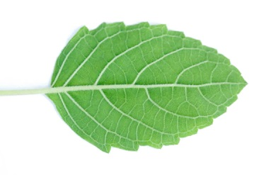
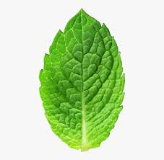
System/Architecture diagram
Leaves having similar shape
Test leaf
Mint leaf
Tulsi leaf
Feature Extraction
Output
Tulsi (Ocimum tenuiflorum)
Classifier
Shape
Colour
Texture
Feature Vector
8.

Slide 11


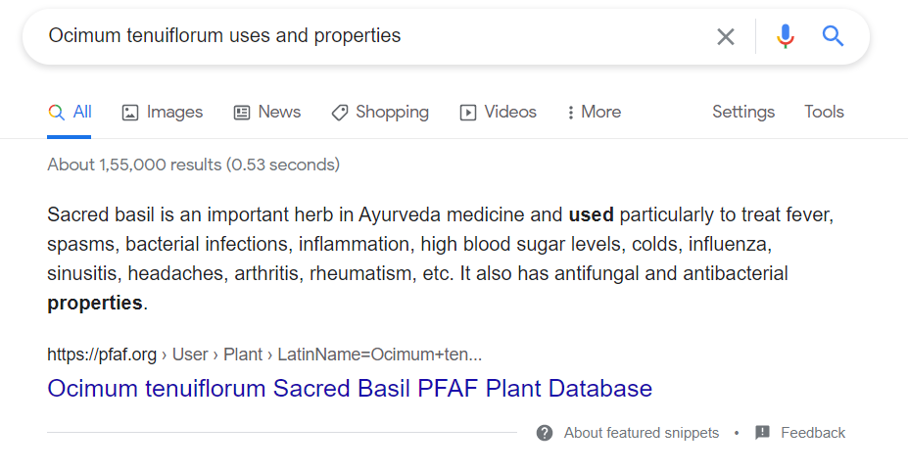
Output
Tulsi
(Ocimum tenuiflorum)
Python web-browser plugin
Redirecting to Google search page
9.

Slide 12
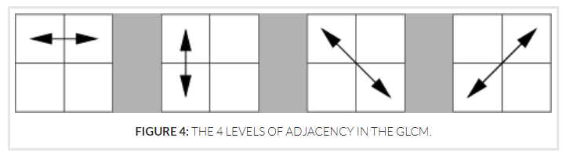
Texture features
Python library Mahotas is used to extract texture features from test image.
Mahotas collects Haralick texture features from image.
Haralick feautres are derived from the Gray Level Co-occurrence Matrix (GLCM).
This matrix records how many times two gray-level pixels adjacent to each other appear in an image.
10.

Slide 13
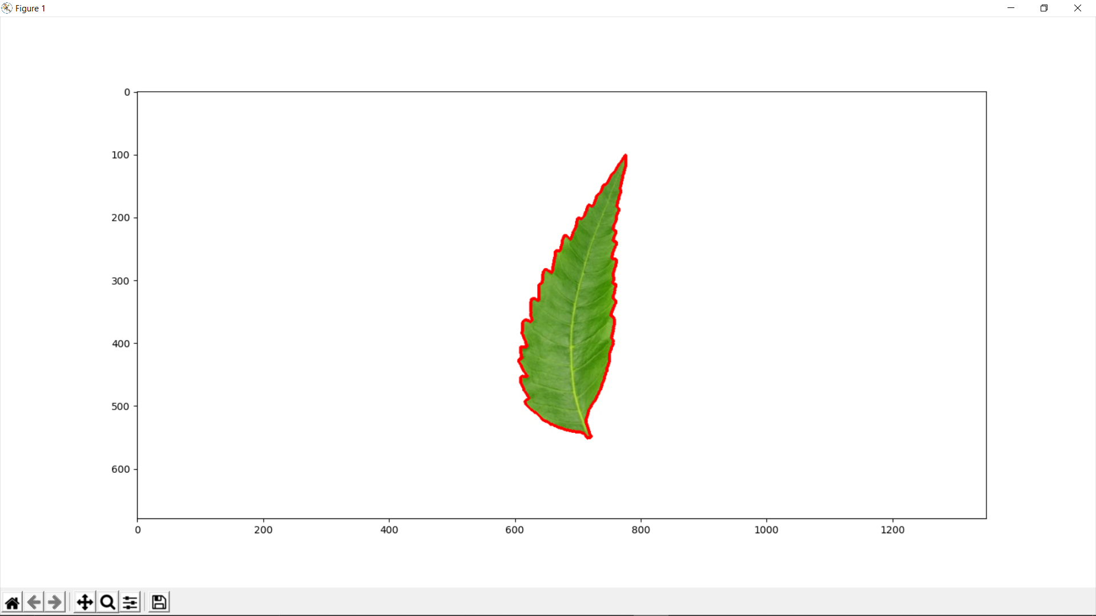
Shape Features
Opencv FindContours() is used to find the contour with maximum area.
Area, perimeter, rectangularity etc. of this largest contour provides with shape features of enclosed leaf.
11.

Slide 14
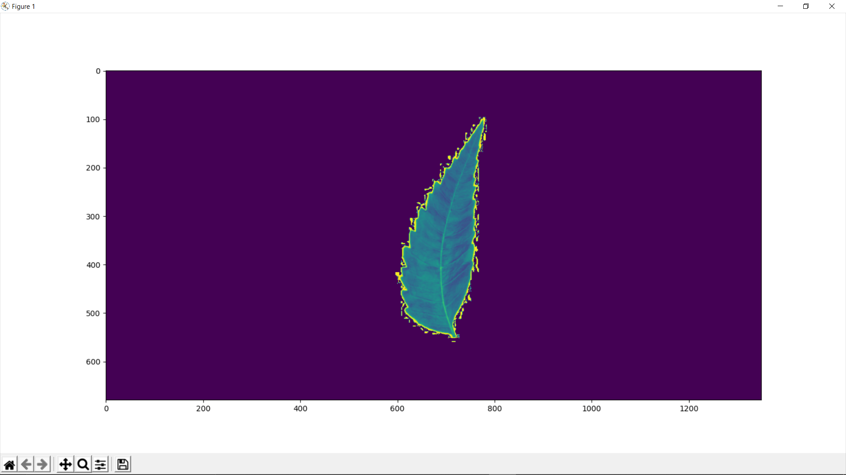
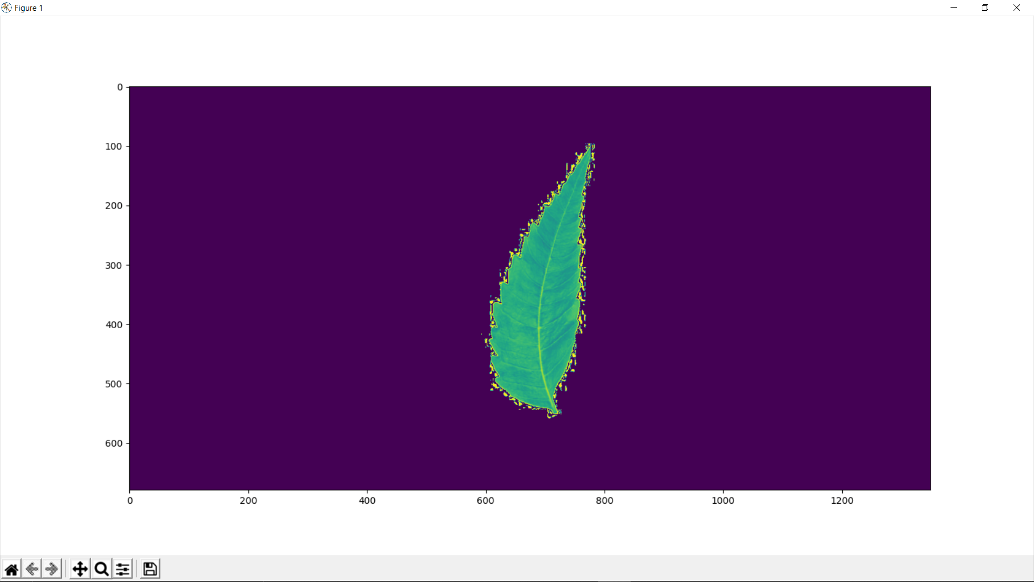
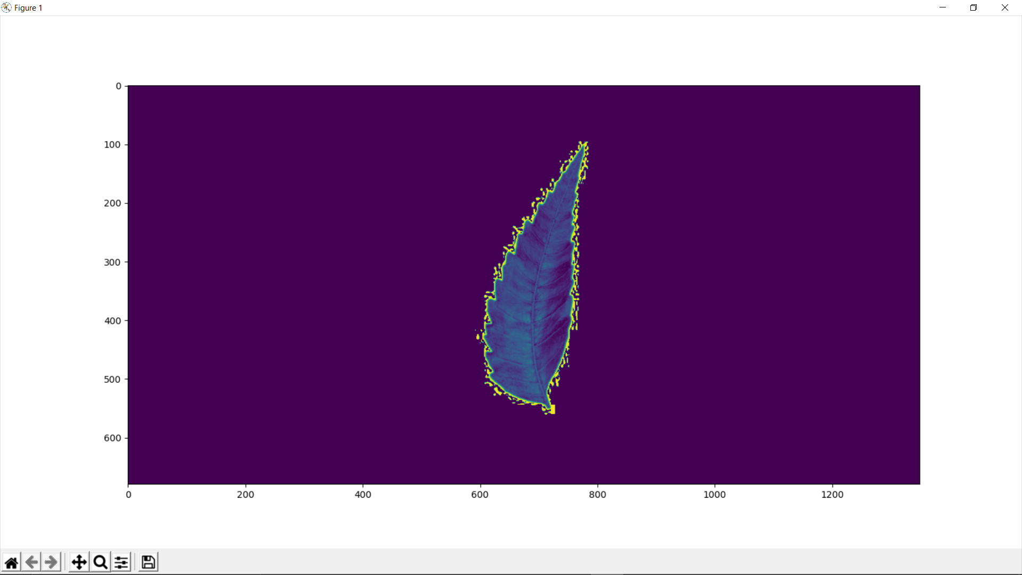
Colour Features
Every RGB image can be split up into the red, green and blue channels.
Mean and standard deviation of these channels provides with colour based features of leaves.
Red
Green
Blue
12.

Slide 15
USER INTERFACE
Python package called tkinter allows features and utilities to develop custom user interface.
Custom buttons and labels makes application user friendly.
User interface enhances both accessibility and aesthetics.
Callback functions attached with buttons allows communication between user input and back-end sections of code.
13.

Slide 16
HARDWARE/SOFTWARE SPECIFICATION
Software requirement:
Coding: Python(using open CV) and various python packages like skimage , numpy, matplotlib,web-browser,tkinter(for GUI),sklearn(for SVM).
Operating System: Windows 10.
Other applications : Git, Github repositories.
Hardware requirement:
NVIDIA GTX 1050 graphic card ,12 GB RAM is used for the project.
14.

Slide 17
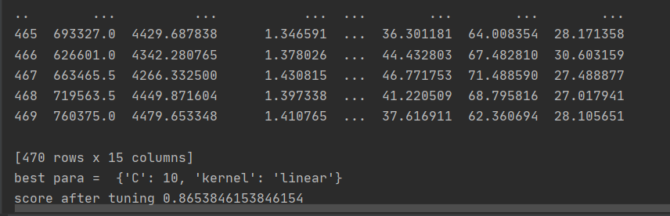
RESULTS
Features | Classifier | Accuracy | Dataset | Training | Testing | Species | Samples
Shape, texture, color | SVM | 86.5% | 470 | 315 | 155 | 47 | 10
15.

Slide 18
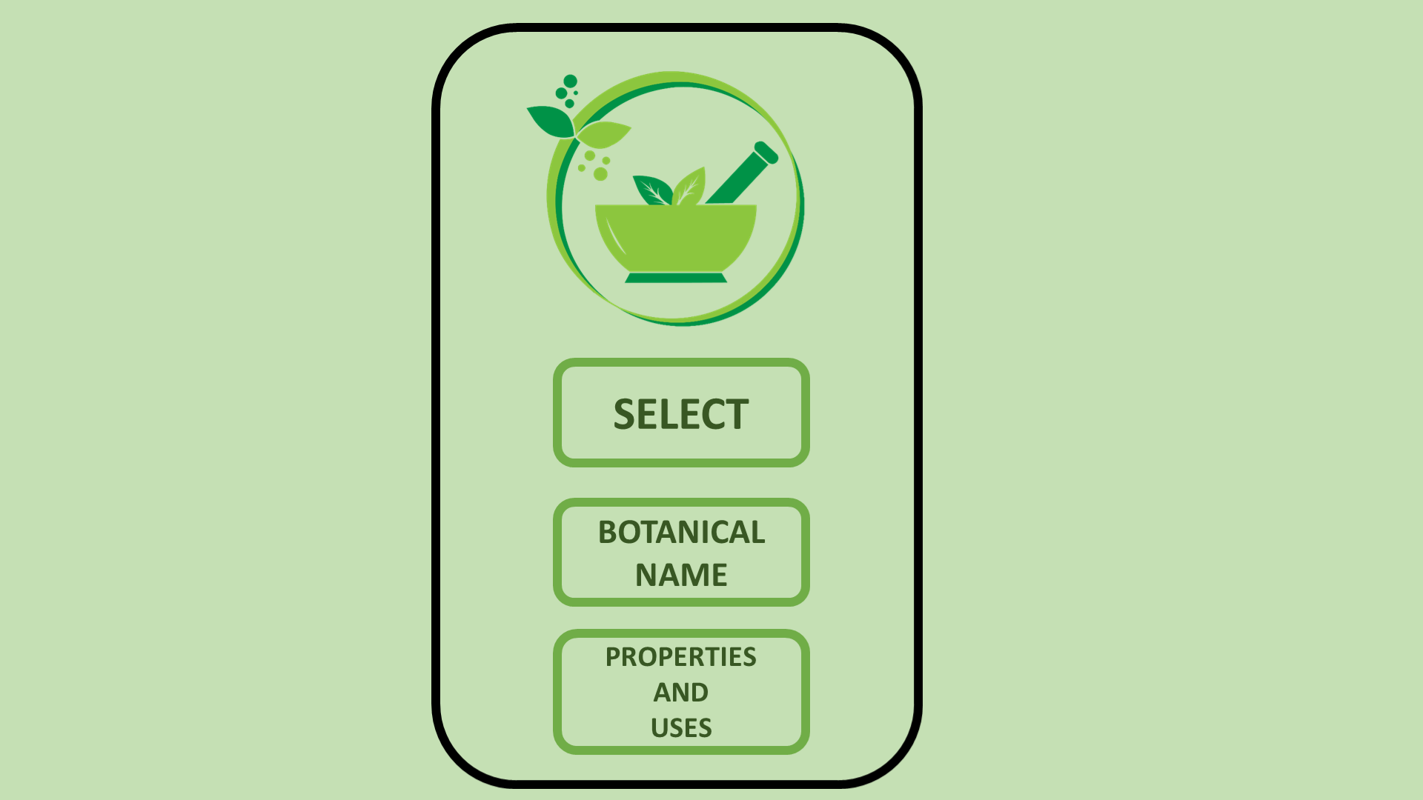
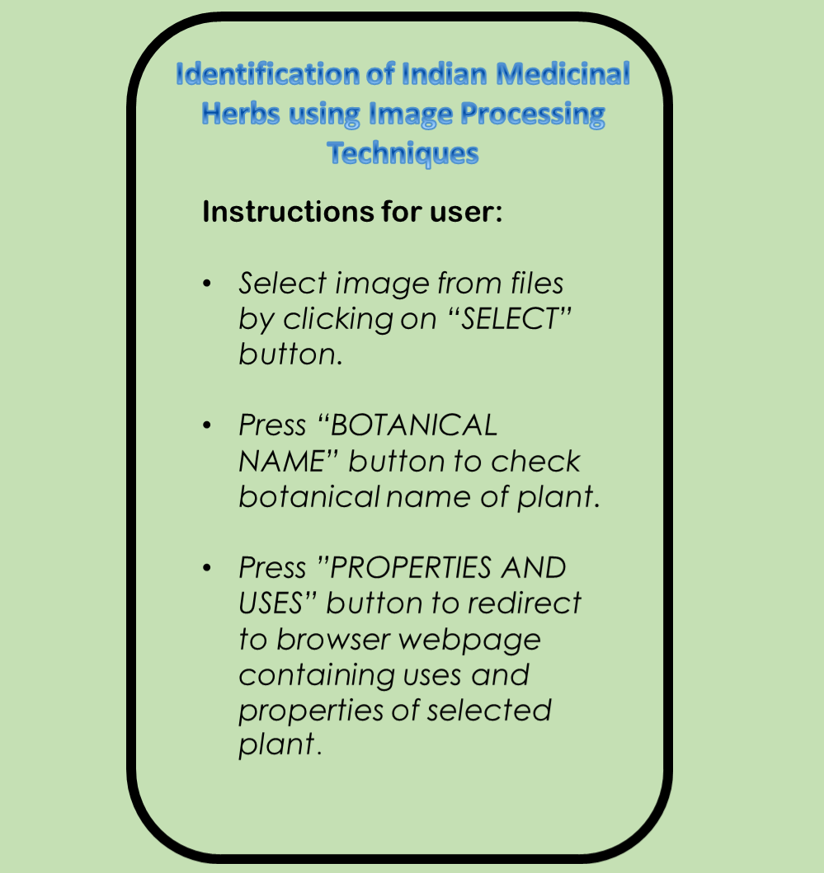
GUI LAYOUT AND UTILITIES
Stucture of user interface consists of left side with clickable buttons and right side with user instructions.
LEFT SIDE RIGHT SIDE
16.

Slide 19
CONCLUSION
In this project multiple algorithms are proposed to identify the given leaf species using image processing in python and then by using browser control feature we will study the uses and properties of the given plant species. To make the model more user-friendly a front-end GUI is developed.
The methods included:
SVM Classifier
Contouring
Feature extraction
Incorporation of web browser control
Python based front-end programming
17.

Slide 20
APPLICATIONS
Major contribution toward farming and botany. Recent studies have proved that these medicinal herbs are beneficial for the current COVID 19 situation.
Ease to find uses and properties of these medicinal plants by just capturing the images.
Can spread awareness towards Ayurveda collaborating with Aayush ministry, Patanjali and other industries related to medicinal plants and herbs.
Standalone dedicated hardware implementing the following algorithms can be constructed.
Software application based on this methodology can be developed for portable devices.
A cloud based storage for dataset will further reduce the on-system memory requirements.
18.

Slide 21
REFERENCES
Dahigaonkar, Tejas D., and R. Kalyane. "Identification of ayurvedic medicinal plants by image processing of leaf samples." International Research Journal of Engineering and Technology (IRJET) 5, no. 05 (2018).
Kalyoncu, Cem, and Önsen Toygar. "Geometric leaf classification." Computer Vision and Image Understanding 133 (2015): 102-109.
Beghin, Thibaut, James S. Cope, Paolo Remagnino, and Sarah Barman. "Shape and texture based plant leaf classification." In International conference on advanced concepts for intelligent vision systems, pp. 345-353. Springer, Berlin, Heidelberg, 2010.
van der Walt, Stefan and Sch ´ onberger, Johannes and Nunez-Iglesias, ¨ Juan and Boulogne, Franc¸ois and Warner, Joshua and Yager, Neil and Gouillart, Emmanuelle and Yu, Tony and contributors, the. (2014). scikitimage: Image processing in Python. PeerJ. 2. 10.7717/peerj.453.
Elhariri E., El-Bendary N., Fouad M.M.M., Platos J., Hassanien A.E., Hussein A.M.M. (2014) Multi-class SVM Based Classification Approach for Tomato Ripeness. In: Abraham A., Kromer P., Snasel V. (eds) Innovations in Bio-inspired Computing and Applications. Advances in Intelligent Systems and Computing, vol 237. Springer, Cham.
19.

